Slide 1

Team Details
Team name: Digital Defenders
Team leader name: Rohit Yadav
Problem Statement: Smart Web Application for Accident and Emergency cases

Slide 2
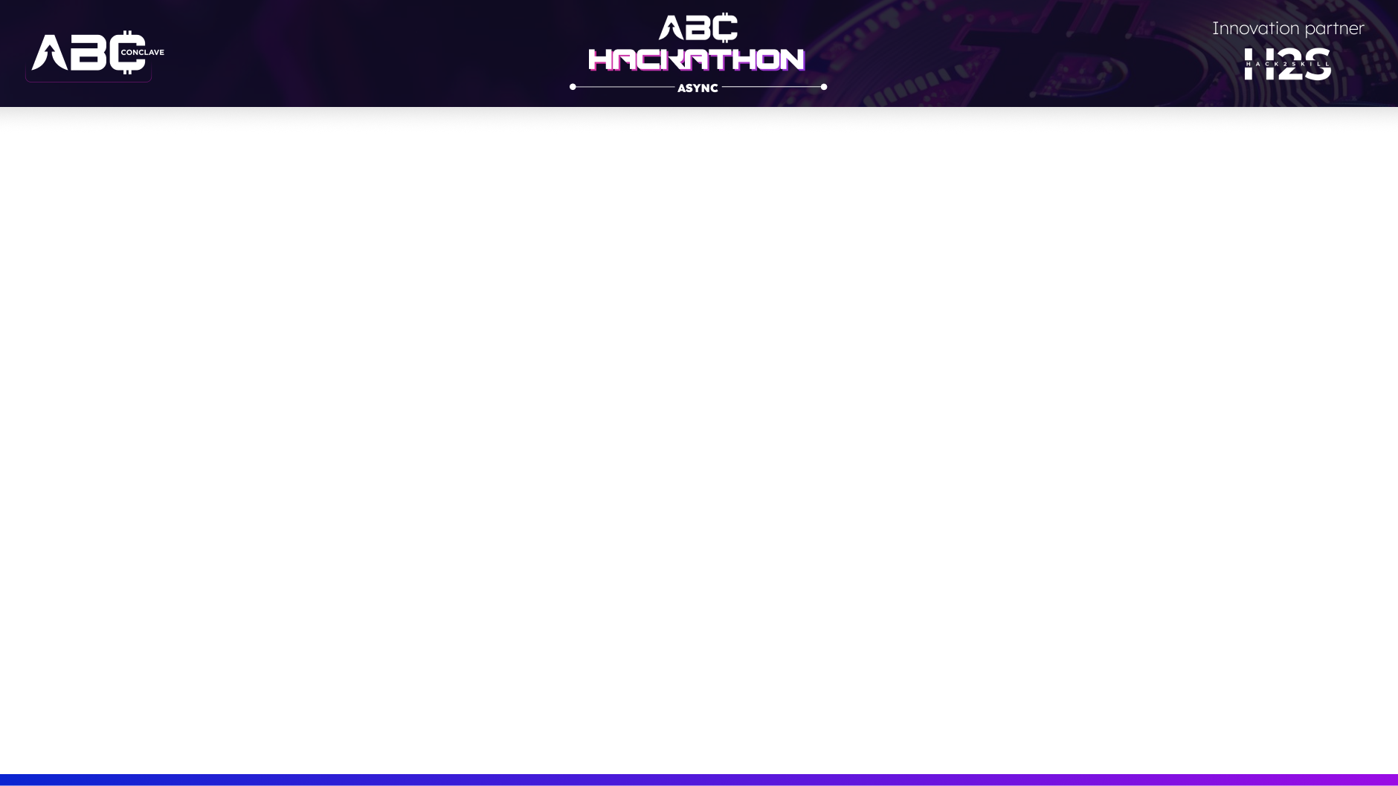
Brief about the idea
Implementation of web application services for Accidental
& Emergency hospital cases
Develop a comprehensive web application that integrates real-time data, communication tools, and resource management systems to enhance the efficiency of accident and emergency services.
The application would serve as a centralized platform for emergency responders, hospitals, and citizens, aiming to improve response times, coordination, and overall service effectiveness.
These challenges can lead to longer wait times and increased pressure on medical staff .Due to lack of patient empty emergency beds .
Even after reaching the hospitals, many such cases are seen in which due to lack of emergency beds in the hospital, the condition of the patient becomes very bad and in such a situation they even dies.

Slide 3
Opportunities
a: Scope and Specificity:
Emergency Hospital Cases: The focus here is on immediate, urgent responses to accidents and emergencies. This typically involves features like real-time case tracking, triage prioritization, and integration with emergency response systems.
Functionality and Features :
Real-time Incident Tracking: Provides immediate updates on emergency cases, including patient status and location.
Triage and Prioritization: Features to categorize cases based on urgency and resource needs.
Integration with Existing Systems : Integration with Emergency Response Systems: These applications often need to integrate with local emergency services, public safety systems, and possibly regional health databases.

Slide 4
List of features offered by the solution
Real-Time Incident Reporting:
•Feature: Allow users to report accidents or emergencies through a web interface.
•Implementation: Use geolocation APIs to pinpoint exact locations and provide a user-friendly form for quick incident reporting.
Real-Time Tracking and Communication:
•Feature: Enable real-time tracking of emergency vehicles and provide communication
channels between responders and dispatch centers.
•Implementation: Use GPS tracking, mobile notifications, and real-
time chat functionalities. Implement push notifications for status updates.

Slide 5
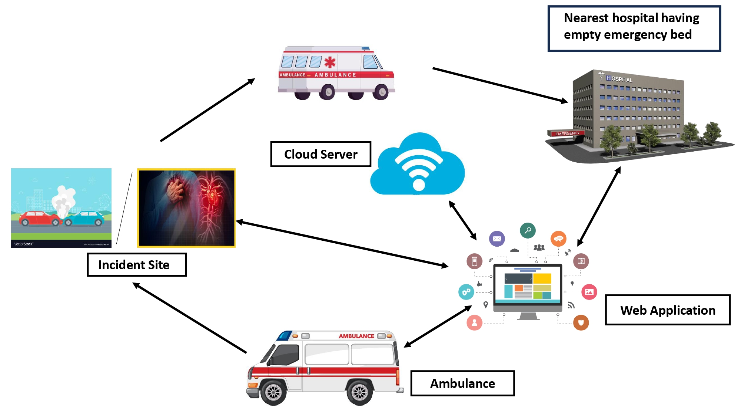
Process flow diagram or Use-case diagram

Slide 6
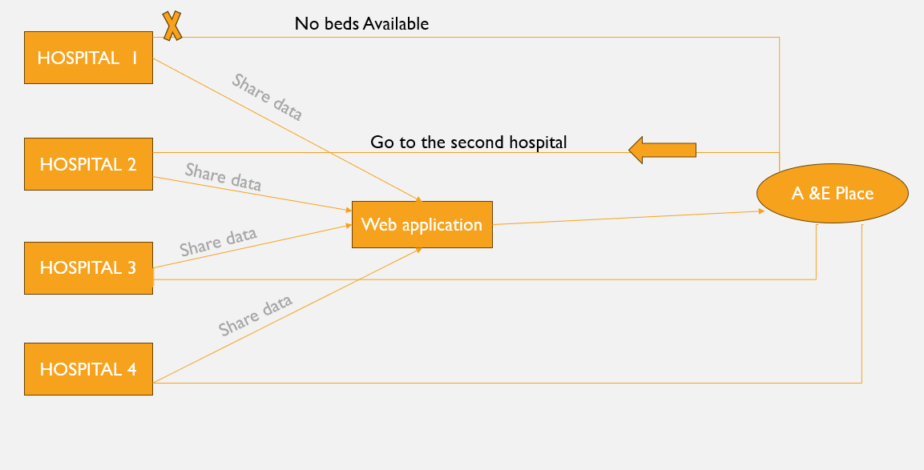
Wireframes/Mock diagrams of the proposed solution (optional)
Latest root
Everything available

Slide 7

Architecture diagram of the proposed solution
User
Application
Database
1.Instalation
2.Health Cases
4.Access Granted
3.Credentials matched
5.Select Emergency Services
6.Request information
8.Viev service details
7.Information Sent
9.Report emergency
10.Submit information
11.Confirmation with report ID
12.Change settings
13.Submit Information
14.Changes saved

Slide 8
Technologies to be used in the solution:
Frontend: HTML, CSS, JavaScript, and modern frameworks like React.js .
Backend: Node.js with Express.js, Python with Django or Flask.
Database: Relational databases like PostgreSQL or MySQL for structured data.
Cloud Services and Hosting: Cloud platforms like AWS, Google Cloud, or Azure for hosting, scalability, and additional services.
Real-Time Communication: Web Sockets or libraries like Socket.IO for real-time communication features.

Slide 9
Estimated implementation cost (optional)
No cost for any implementation .

Slide 10
Snapshots of the prototype:
Login/Authentication Screen
Dashboard
Case Management Screen
Patient Information Screen
Notification Screen
Reports and Analytics Screen

Slide 11
Prototype Performance report/Benchmarking:
Executive Summary
Objective: Assess the prototype’s performance in handling accidental and emergency hospital cases, including responsiveness, reliability, and resource usage.
Key Findings: Summarize major performance metrics and any identified bottlenecks or issues.
Recommendations: Provide actionable suggestions based on the performance data.
Test Environment
Software Configuration:
Server Operating System: Version and configuration.
Web Server: Type (e.g., Nginx, Apache) and version.
Database: Type (e.g., PostgreSQL, MongoDB) and version.
Application Stack: Technologies used (e.g., Node.js, Python, React).
Load Handling:
Concurrent Users: Number of simultaneous users the system can support before performance degradation.
Stress Testing Results: Behavior of the system under extreme conditions (e.g., 1000+ simultaneous users).

Slide 12
Additional Details/Future Development (if any):
Predictive Analytics: Integrate machine learning models to predict high-risk cases based on historical data and trends.
Real-Time Data Visualization: Implement advanced visualizations for better understanding of live data and trends.
Improved User Experience:
User Training: Provide comprehensive training materials and sessions for users to efficiently utilize advanced features and tools.

Slide 13
Provide links to your:
GitHub Public Repository
Demo Video Link (3 Minutes)
Final Product Link

Slide 15


